Slide 1
Functional literacy and critical thinking skills

Slide 2
A person is functionally literate who can engage in all those activities in which literacy is required for effective functioning of his group and community and also for enabling him to continue to use reading, writing and calculation for his own and the community’s development (UNESCO)
Functional literacy - the ability to understand and employ printed information in daily activities, at home, at work and in the community – to achieve one’s goals, and to develop one’s knowledge and potential (OECD)

Slide 3
The level of students’ functional literacy - an indicator of success of contemporary educational systems in the world
Basic literacy (knowing how to use the alphabet) – not enough in a modern world
Functional literacy – not a dichotomy, but a continuum
Higher functional literacy – better academic achievement, career opportunities, quality of life, health..
Functional literacy: reading (prose and document), mathematics, science
PISA tests, Serbia – low level of functional literacy

Slide 4
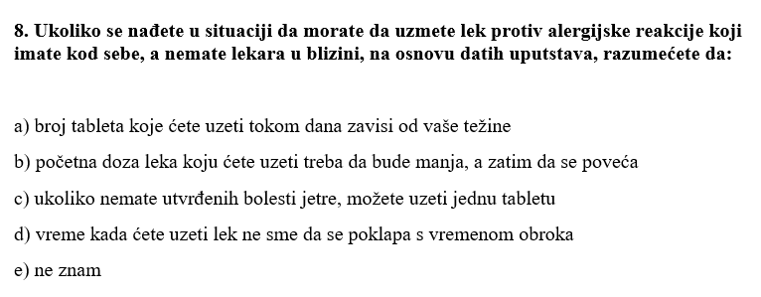

Slide 6
Developing critical thinking skills
Functional literacy – one of the basic educational goals around the world
Half a centuru ago – teaching: providing information; nowadays – information available everywhere, goals changed
from memorising to learning how to use and manipulate information in order to achieve academic and professional goals or to raise the quality of life
Functional literacy dependent on critical thinking skills
Critical thinking does not involve developing a negative, judgmental attitude
It is is the construction of knowledge on the part of the student and not its mere reception
It requires that the student compare, contrast, analyse, synthesize and evaluate information in order to construct knowledge that is based on evidence and devoid of prejudices

Slide 7
Students who think critically
More tolerant and curious
Make decisions more effectively
Memorize for a longer time
Have a broader understanding of the material

Slide 8
Levels of critical thinking
The ability to understand and manipulate information gradually developed
Stages that involve cognitive activities of different complexity:
Remembering – retrieving, recognizing, and recalling relevant knowledge from long-term memory.
Understanding – constructing meaning from oral, written, and graphic messages through interpreting, exemplifying.
Application - selecting, transferring, using or applying data to solve a problem or perform a task.
Analysis – distinguishing, classifying, relating, analysing, categorizing, and comparing assumptions and evidence.
Evaluation - assessing, appraising, and critiquing information.
Creating - putting elements together to form a coherent or functional whole; reorganizing elements into a new pattern or structure.

Slide 9
Developing critical thinking skills involves:
Focusing not only on reproduction and understanding, but leading students to the higher levels of cognitive processing
Asking questions, particularly open-ended questions (explain, compare, illustrate…)
Asking ’Socratic questions’ – dialogue or discussion with the teacher – planned in advance and scaffolded appropriately so that they enable discovering ideas, correcting misconceptions, creating knowlede or challenging the students

Slide 10
Socratic questions:
(1) Questions of clarification. They are used to explain what exactly somebody thinks about something and to prove concepts behind arguments. They include questions such as: What do you mean by that? What is your main point? Could you give me an example?
(2) Questions that probe purpose. They are aimed at clarifying the purpose of what is being said / discussed. Examples include the following: What is the purpose of X? What was your purpose when you said X?
(3) Questions that probe assumptions. This type of questions is used to challenge presuppositions and unquestioned beliefs. Exemplary questions are: What are you assuming? What could we assume instead? You seem to be assuming X. Do I understand you correctly?
(4) Questions that probe information, reason, evidence and cause. When asked a question of this type, a student is challenged to provide a rationale for his argument. Typical questions are: What would be an example? How do you know? What are your reasons for saying that?

Slide 11
(5) Questions about viewpoints and perspectives. These questions challenge the position a student is taking. Example questions include the following: Can anyone see this any other way? What would someone who disagrees with you say?
(6) Questions that probe implications and consequences. This type of questions is aimed at helping students correct their misconceptions and thus foresee the real implications and consequences of their thinking. Typical questions include: What are you implying by that? If that happened, what else would also happen as a result?
(7) Questions about the question. They help the student rethink the whole issue being discussed. Exemplary questions are: How can we find out? What does this question assume? Why is this question important?
(8) Questions that probe concepts. Their purpose is to challenge the understanding of the concept dealt with. Typical questions include: What is the main idea we are dealing with? How / Why is this idea important?
(9) Questions that probe inferences and interpretations. These questions are used to help student rethink the conclusions made and inferences drawn. Typical questions are: On what information are we basing this conclusion? How did you reach that conclusion? How shall we interpret these data?

