Slide 1
Resource materials, lesson plan

Slide 2
Resource materials
whole range of useful resource materials available nowadays: pictures, drawings, video materials, recordings, computer games, posters, picture postcards, flashcards, toys, extracts from newspapers and magasines, cd-s
the question – whether to use authentic or adapted materials – with lower level students, adapted materials are better
most widely used – the coursebook
the content of the cb should be compatible with the content of the syllabus
teachers can rely on well-organised selection of appropriate and versatile language input, such as dialogues, texts, grammar and vocabulary exercises, illustrations, suggestions for speaking practice
modern coursebooks - aimed at developing all language skills, come with accompanying teacher’s books and CDs

Slide 3
Choosing the coursebook:
The price
Add-ons and extras (workbook)
Design
Instructions
Methodology (what kind of learning/balance between study and activity)
Syllabus
Skills
Topics
Cultural appropriacy
Teacher’s guide

Slide 4
Even when using the best coursebook, if it is followed too strictly and used as the only resource material, there is a danger of getting ’locked’ into the book!

Slide 5
Lesson planning
essential, particulary for novice teachers
the teacher should have a very clear idea of what their goals are and what the students are expected to achieve
important: the selection of activities and the appropriate sequencing
the beginning – a warm up activitity (a few minutes)
the end – revision, summary, giving homework
the middle part – usually PPP (presentation, practice, production)
not all the three have to be done during one class
the order can be altered

Slide 6
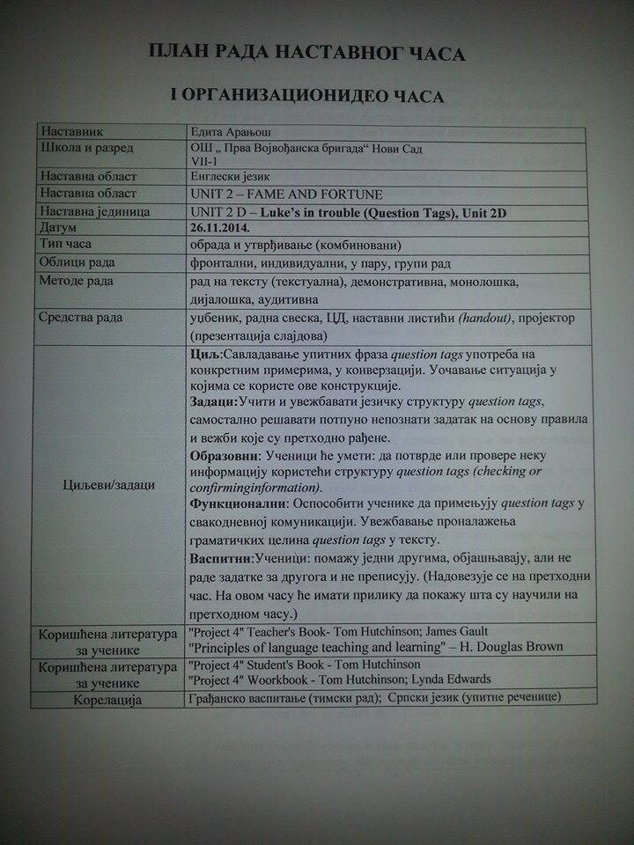

Slide 7
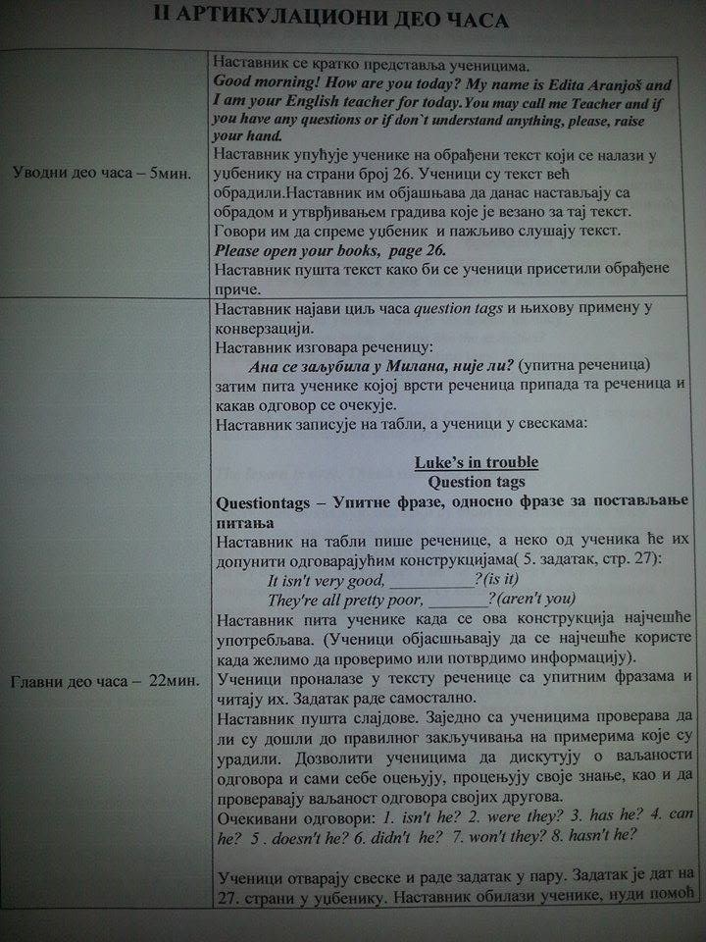

Slide 8
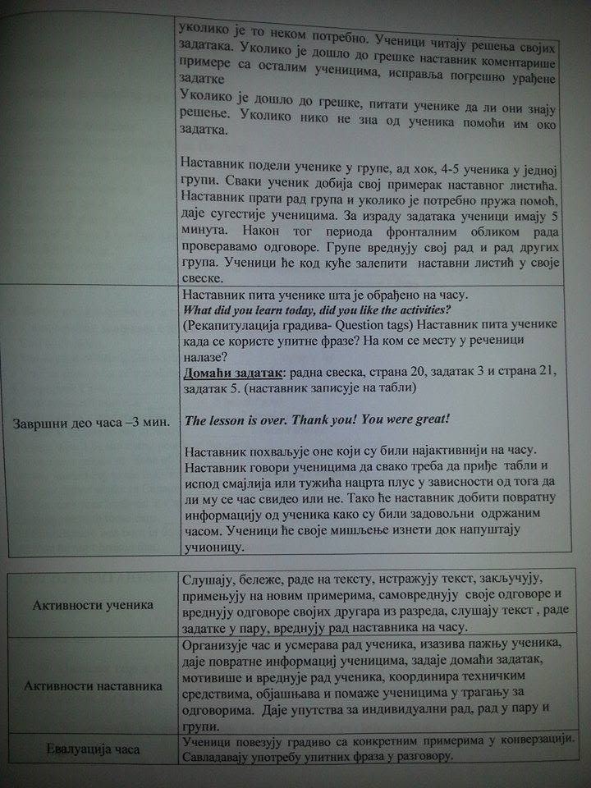

Slide 9
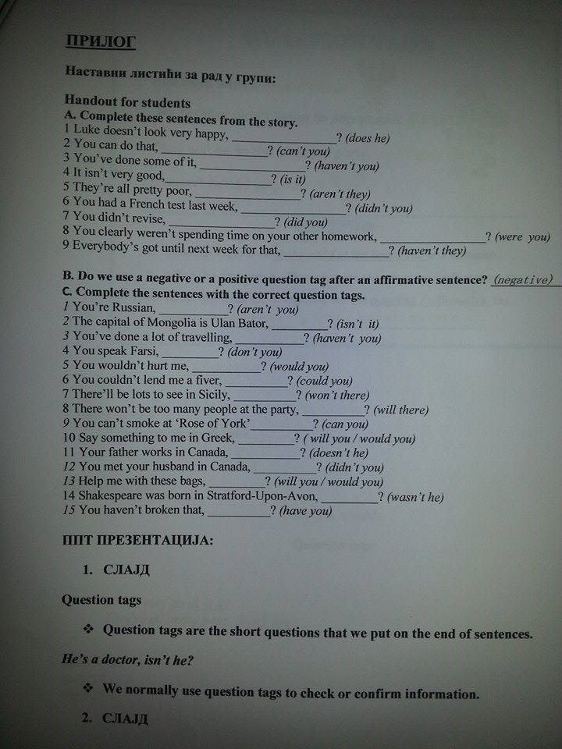

Slide 10
